Slide 1
11%
„Cementbag” company growth
CAGR
35mln
3050

Slide 2
„Cementbag” company growth
11%
CAGR
48mln
46mln
45mln
45mln
39mln
35mln
3050
3051
3052
3053
3054
3055

Slide 3
„Cementbag”
company growth 3050-3055
11%
CAGR
48mln
46mln
45mln
45mln
39mln
35mln

Slide 4
Sample data:
Flour sales between 3050-3053, in mln. units
 | Value
3050 | 35,001
3051 | 39,147
3052 | 44,607
3053 | 48,321
3054 | 45,128
3055 | 46,889
3050 $35,000,000.00 (Starting Value)
3051 $39,147,206.60 (CAGR: 11.6%)
3052 $44,607,468.29 (CAGR: 13.2%)
3053 $48,321,193.38 (CAGR: 7.4%)
3054 $45,128,532.40 (CAGR: -6.7%)
3055 $46,889,581.08 (CAGR: 3.9%)
3056 $60,613,348.38 (CAGR: 29.4%)
3057 $90,513,236.89 (CAGR: 49.2%)
3058 $134,686,313.93 (CAGR: 48.7%)
3059 $219,998,229.16 (CAGR: 63.0%)
3060 $374,139,249.99 (CAGR: 70.3%)

Slide 5
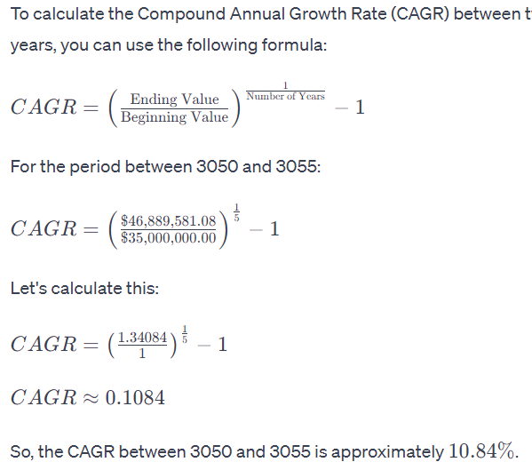
CAGR between 3050 and 3055 is ~11%
3050 $35,000,000.00 (Starting Value)
3051 $39,147,206.60 (CAGR: 11.6%)
3052 $44,607,468.29 (CAGR: 13.2%)
3053 $48,321,193.38 (CAGR: 7.4%)
3054 $45,128,532.40 (CAGR: -6.7%)
3055 $46,889,581.08 (CAGR: 3.9%)
3056 $60,613,348.38 (CAGR: 29.4%)
3057 $90,513,236.89 (CAGR: 49.2%)
3058 $134,686,313.93 (CAGR: 48.7%)
3059 $219,998,229.16 (CAGR: 63.0%)
3060 $374,139,249.99 (CAGR: 70.3%)

